Slide 1

Business plan of Money lending business in Indonesia
Business plan of Money lending business in Indonesia
11.12.2015

Slide 2
Table of contents
1 | Investment summary | 3
2 | Market overview | 5
3 | Legal setup | 13
4 | Product and business processes | 20
5 | Marketing | 33
6 | Risk Management | 37
7 | Finance and Admin | 45
8 | Project risks and mitigation | 53
9 | Project plan and next steps | 55

Slide 3
Investment Summary
Indonesia is very promising market due to its size and supply glut in consumer finance services. We plan step-by-step penetration to capital metropolitan area of Greater Jakarta, Java Island, and other big cities. Indonesia is one of the biggest markets in A&P orbit:
Total population is 253M.
Our target segment will grow from 100M to 160M in 2012-2020¹.
Only 23% of retail borrowers use formal financing channels:
Loan market is strictly regulated and has high requirements for borrowers and provides limited offering of uncollateralized cash loans.
Local mentality is relationship-driven and most of lending/borrowing activities are run via friends and family (F&F).
PDL market is in grey zone and not regulated, mostly represented by Black Money Lenders (BML).
We see huge opportunity for our business model in transferring lending/borrowing practices to digital lending by offering the product that is:
Really fast – credit decision to be obtained within hours, not days.
Convenient – without necessity to go to the branch and sign papers.
Accessible – easy to apply in 24/7 mode.
Our key challenges are:
Absence of conventional licensing options to meet our business model requirements.
Credit risks due to lack of borrowers’ checking capacities.
¹Solidiance marketing agency analysis

Slide 4
Investment Summary
Investment summary |  |  |  | Timeline
thsd USD | Q4’2015 | Year 1 | Year 2 | Year 3 | Year 4 | Year 5* | Total
investments | 201 | 6 663 | 3 590 | 576 | 0 | 0 | 11 030
Total investments | 201 | 6 663 | 3 590 | 576 | 0 | 0 | 11 030
Number of loans issued (thsd) | 0,02 | 41 | 151 | 286 | 408 | 464 | 1 350
Amount disbursed | 3 | 8 438 | 32 726 | 63 401 | 91 682 | 105 535 | 301 786
Net portfolio (EoY) | 1 | 2 148 | 6 155 | 10 837 | 14 555 | 15 708 | 15 708
Revenue | 0 | 2 782 | 14 095 | 29 528 | 44 915 | 53 942 | 145 262
One-off expenses | 0 | -908 | 0 | -27 | 0 | 0 | -935
Net profit after taxes | -198 | -3 491 | 744 | 4 508 | 9 144 | 12 807 | 23 512
ROE (yearly) | -197% | -91% | 8% | 40% | 78% | 110% | 51%
ROAA (yearly) |  | -184% | 12% | 42% | 60% | 73% | 39%
* - normalized year with no growth
Break-even period – 20 months.
Payback period – 50 months.
Maximum investments from – $11,0M.

Slide 5
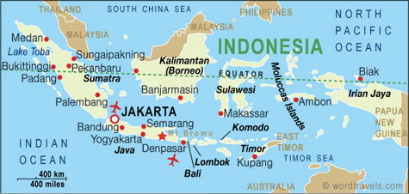
General market information
Geographic area is 1.9M km^{2.}
Total population is 253M; Java Island is 140M, Greater Jakarta is 30M.
Official language is Bahasa.
GDP per capita (Nominal) is $3,6k¹ nationwide and >$10k in Jakarta.
Average monthly income is $250³ nationwide ($740⁴ in Jakarta).
Mobile phone penetration is 108% nationwide (180% in Jakarta^{5).}
Smartphone penetration is 25%⁶ nationwide (55%⁹ in Jakarta).
Internet penetration is 36% nationwide (65% in Jakarta⁶).
Facebook penetration is 28%⁷ nationwide.
Bank account penetration is 25%⁶ nationwide.
Formal lending sources penetration is 23%⁶ nationwide.
Online-banking penetration is 11%⁶ nationwide.
Credit cards penetration is 6%⁶ nationwide.
Debit cards penetration is 40%⁶ nationwide.
Taxable population rate is 11%⁹ nationwide.
¹ World Bank
² http://www.oecd.org/eco/surveys/Overview-Indonesia-2015.pdf
³ http://bisnis.liputan6.com/read/2171479/di-2014-orang-ri-kantongi-penghasilan-rp-418-jutatahun
⁴ http://data.jakarta.go.id/dataset/pendapatanperkapitajakartadannasional/resource/8043ea60-9c7d-4948-8d61-2cc2622b0ee0
⁵ http://ugm.ac.id/id/berita/8776-menkominfo%3A.270.juta.pengguna.ponsel.di.indonesia
⁶ Solidiance marketing agency analysis
⁷ http://blogs.wsj.com/digits/2014/06/27/facebook-users-in-indonesia-rise-to-69-million/
⁸http://tekno.liputan6.com/read/2197413/jumlah-pengguna-internet-indonesia-capai-881-juta
⁹http://economy.okezone.com/read/2015/04/29/20/1141734/jokowi-kaget-dari-250-juta-penduduk-hanya-10-juta-bayar-pajak

Slide 6
General market specifics
GDP is driven by following industries:
Services 41%.
Manufacturing 24%.
Agriculture 15%.
Mining 10%.
Construction 10%.
Population’ financial literacy is very low, making it an easy target for Black Money Lenders
Huge share of unofficial employment creates difficulties in determining the difference between individual borrowers and Micro, Small and Medium enterprises (MSME), thus they are basically inseparable
MSMEs numbers are estimated at 50-60M, comprising 57% of GDP¹
Despite the wide spread of Islam (88% of the population):
Indonesia is a secular state with democratic rule.
Religion is not affecting peoples behavior and payment discipline.
Sariah banking accounts for less than 5% of the banking system.
Payment discipline could be affected by:
Family culture - close relatives are likely to repay the loans for borrowers or motivate them to do so.
Workplace reputation - contacting HR departments is a powerful took to motivate borrowers to repay the loan.
Active social network usage (namely Facebook) provides opportunities for:
Initial online social scoring assessment (social validation).
Current borrowers behavioral analysis and reactive approach.
Powerful collection practices.
¹ KPMG estimates.

Slide 7
Customers Segmentation
Monthly income:
$650 and higher
# | Specifics | Approach
1 | Indonesia consists of 17,5k islands with only 6k being populated | We will approach people living in easy reachable areas
2 | Urban and rural population is split by 143/100M | We will approach urban population with higher average income and internet penetration rate
3 | Income segmentation is per the graph | We will approach the fast growing middle class segment
Upper class, 1-3M
Middle class, 150M
Up to $650
Our Target segment
Poor, 100M
Less than $60
Rural, 110M
Urban, 143M
Our target market size is 100M individuals - middle class living in easy reachable urban areas

Slide 8
Consumer lending landscape intro
Lending activities initially developed via 2 streams:
Commercial banks:
Appeared under Dutch rule (1602-1942).
Historically focused on commercial lending.
After 1997 crisis the market was open to foreign ownership, now the access is limited and the attitude towards foreign ownership is worsening.
Cooperatives and Micro-finance institutions (MFIs):
Are the oldest traditional financial institutions.
Currently are focused on community-based consumer and MSME loans.
Are forerunners of modern rural banks.
Recently 2 other types of financials institutions branched out:
Rural banks (BPRs):
First one (current BRI) appeared in 1895 and formally recognized in 1978-1992.
Currently are focused on lending/depositing activities in rural areas.
Can operate in a certain province only, do not have right to open branches.
Multi-finance companies (MFC):
Appeared in 1970s to meet increasing demand for financing large infrastructure projects.
After 1997 crisis focused tapped consumer finance.
Local experts believe that soon MFCs will be allowed to enter unsecured consumer finance market.
Finance regulation activities have been recently transferred from Bank Indonesia (BI) to Financial Services Authority (OJK). Currently OJK focuses on:
Increasing financial inclusion, introducing branchless banking regulation for selected banks (outsourcing KYC procedures).
Studying the micro-finance market to develop the respective legislation.
Legalizing widely used (mostly in rural area) unofficial MFIs by enforcing them to obtain license with mandatory 60% state share.

Slide 9
Consumer lending landscape: Banks
Banking market is highly consolidated with top 10 banks accounting for 70% of the total system assets.

Slide 10
Consumer lending landscape: MFCs
Largest MFCs assets size is not comparable with largest banks. Foreign ownership is dominating among top-10 MFCs.

Slide 11
Consumer lending landscape: Rural Banks and Cooperatives
Both are not subject to foreign ownership and nominee scheme will not be feasible. Market experts believe that rural banks with time will be cannibalized by commercial banks.

Slide 12
Standard licensing options comparison
# | Parameter | Bank | MFC | Rural Bank | MFI | Pawnshop | Cooperative
1 | Main activities | Full-range banking activity for retail, SME and corporate banking | Specializes on non-cash consumer finance activity | Specializes on loans and deposits in specific provinces | Specializes on microfinance activity with SME on village/city level | State-owned monopoly | Specializes on microfinance and deposits, for members only
2 | Allowed territory of operation | Nationwide | Nationwide | Specific province | Village, Sub-district or Regency/Municipality | Nationwide | Nationwide
3 | Min.capital requirements | $70,000K | $7,000K | $285K-1000K depending on the province | $3,5k for Village $7K for Sub-district $40K for Regency/ Municipality | n/a | $1K
4 | Max. foreign share | 40% (could be increased to 99% by special permission) | 85% | 0% | 0% (and 60% must be state-owned) | 0% | 0%
5 | Ability to sell unsecured cash loans | Yes | No (secured only, for example POS-loans) | Yes | Yes | No | Yes, to members only
6 | Ability to collect retail deposits | Yes | No | Yes | Yes | No | Yes, from members only
7 | Main regulator | OJK | OJK | OJK | OJK | OJK | OJK/Ministry of Cooperative
8 | Average licence obtaining time | >12m | >9m | ~9m | ~6m | n/a | ~6m
9 | Licenses issued and currently operating | ~120 | ~200 | ~1 640 | Up to ~600K | 1 | ~188K
MFC is the most suitable licensing option for conducting lending business among standard options.

Slide 13
MFC and Creative licensing options comparison
# | Parameter | MFC | “Uangteman” (using web portal) | P2P (using web portal)
1 | Main purpose | Specializes on non-cash consumer finance activity | Providing small cash loans to individuals | Acting as an intermediary between individual investors and borrowers, not conducting loans issuances or credit decisioning
2 | Allowed territory of operation | Nationwide | Nationwide | Nationwide
3 | Min.capital requirements | $7,000K | $180k in 6m, $750K in 12m | $180k in 6m, $750K in 12m
4 | Max. foreign share | 85% | 100% | 100%
5 | Ability to sell unsecured cash loans | No (secured only) | Yes | Yes (in the form of loans of individual investors provided to individual borrowers)
6 | Ability to collect deposits from individuals | No | No | Yes, in the form of funding received from individual investors
7 | Main regulator | OJK | Investment Board Coordinator (BKPM) is granting the Web portal license for foreign investments | BKPM is granting the Web portal license for foreign investments
8 | Average license obtaining time | >9m | ~4m | ~4m
9 | Licenses issued/companies operating to the date | ~200 | 1 | 1
10 | Regulatory issues | Fully in compliance with current legislation, no issues | Clearly violating BKPM license because of issuing loans from its own without obtaining a credit institution licence | No signs of violating any current legislation articles of Indonesia (confirmed by legal opinion of reputable local firm)

Slide 14
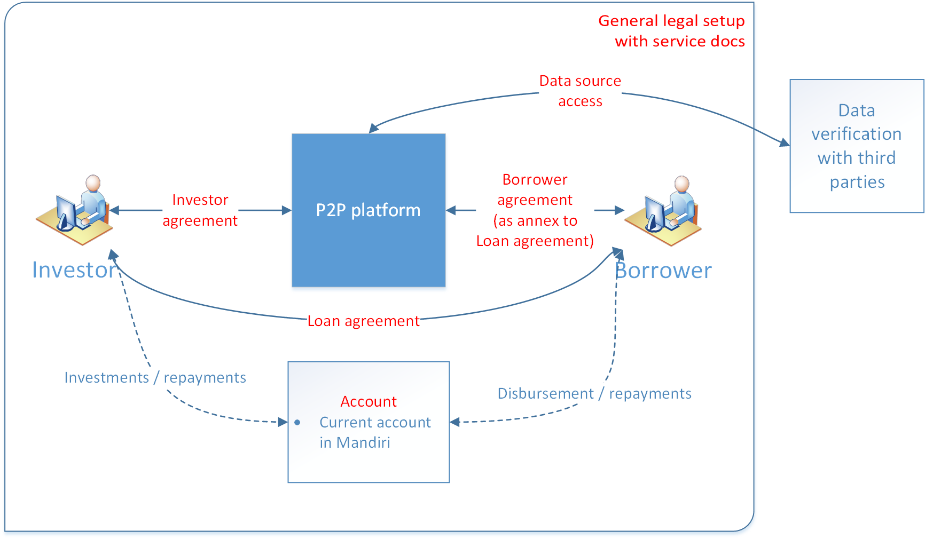
The essence of P2P legal setup
P2P platform acts only as an intermediary among borrowers and investors. Its key activities are:
Providing informational services
Performing data checking for investors
Acting as an intermediary in online documents signature, funds disbursement, repayment and collection.
P2P platform will use innovative mechanisms (i.e. social network scoring) in scoring process.
P2P platform will also provide Investor Reminding service (soft collection).

Slide 15
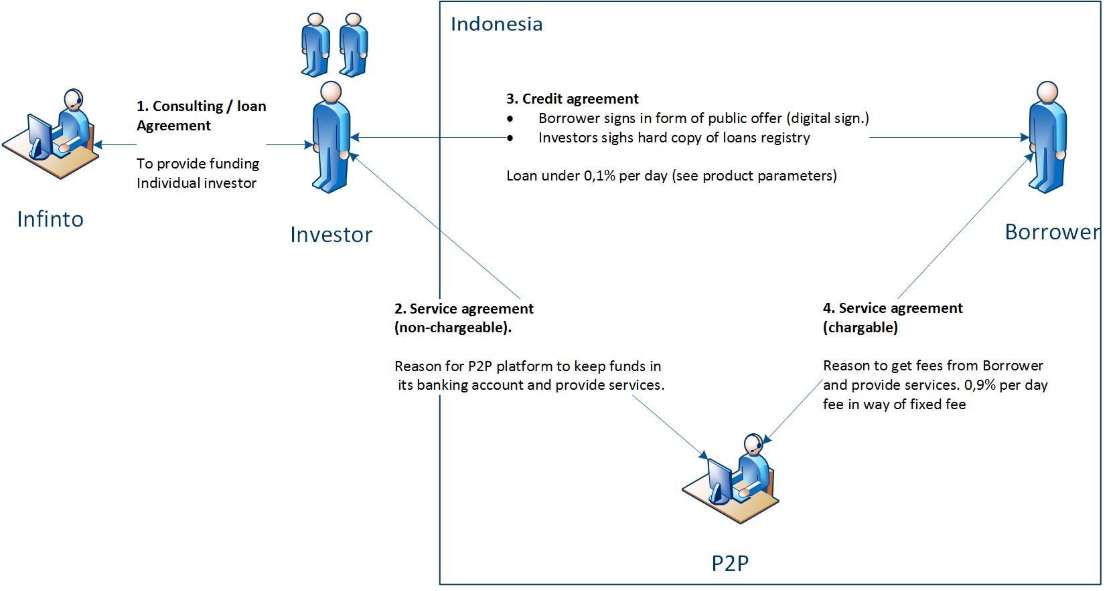
P2P Legal setup contractual relations
P2P phase 1 set-up is based on 4 civil law agreements:
Loan agreement between funding party and Individual investors
Service agreement between PT DSI and Individual investors
Loan agreement between Individual investors and borrowers
Service agreement between PT DSI and borrowers

Slide 16
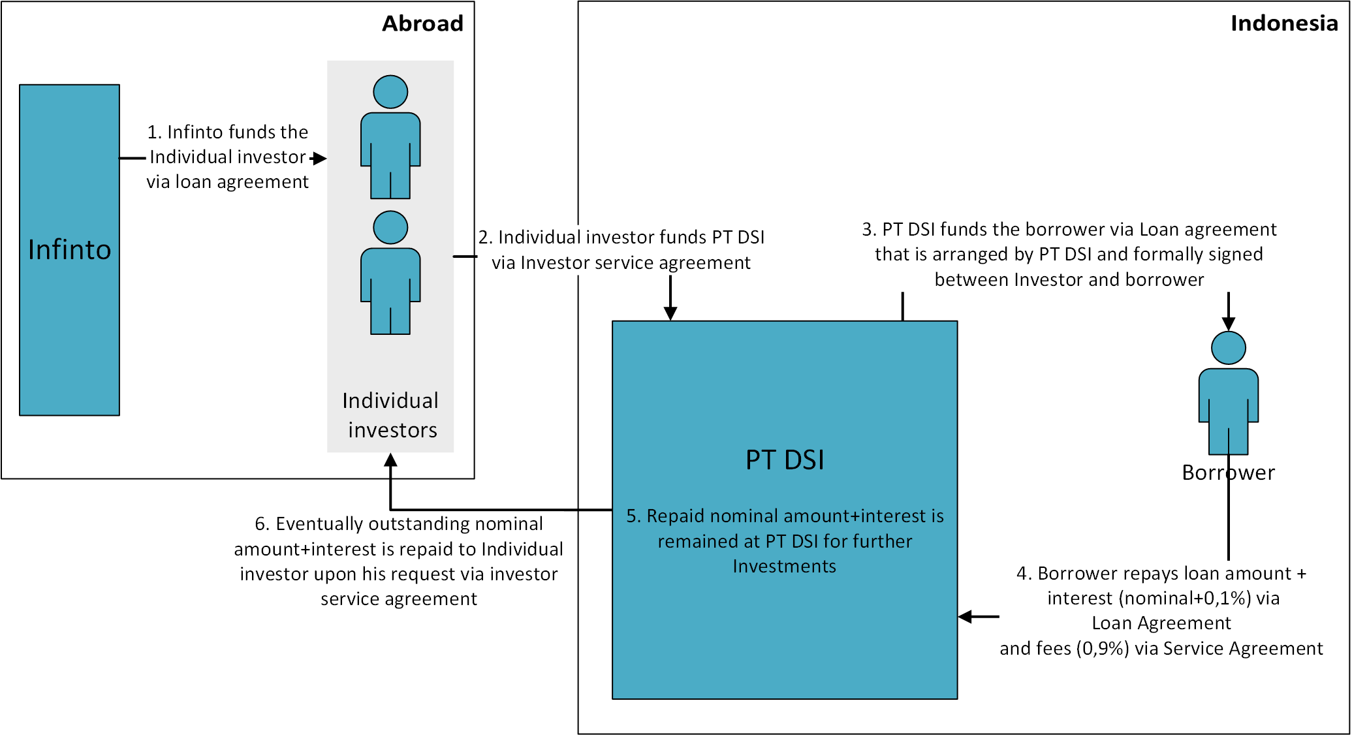
P2P Legal setup business processes

Slide 17
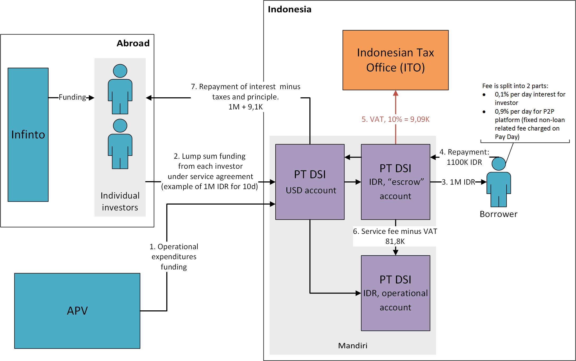
P2P Legal setup cash flow
On phase one funding is provided from our capital to affiliated individual investor, who then sends funds to PT DSI USD account. These funds are stored at special current account, main purpose of which is to hold investors' funds ("escrow" account). "Escrow" account should be separated from operational one. Later these funds are disbursed to borrower's banking account on behalf of investor.
PT DSI acts like a tax agent for Borrowers and Investors, so it pays VAT on their behalf from every repayment received. After subtracting service fees, PT DSI repays interest to affiliated investor.
Operational expenses are funded through shareholder company (APV) loans.

Slide 18
P2P development phases
We plan to develop P2P platform using the following phases:
Phase 1. P2P – one investor
(Q4’2015)
Phase 2. P2P –multiple individual investors (Q2’2016)
Phase 3. BP2P – individual and institutional investors
(in 2017)
After the service grows we plan to provide institutional investors possibility to invest in our service.
Start with set up with only one investor. All the loans will be issued by him. Loan agreements are signed by the Investor offline. Platform will obtain its profit through charging Investor with a set of fees, basing on service agreement.
At this phase we plan to present new credit products (for example, installment loans) as we will receive respective funding from institutional investors.
At this phase we also plan to present a “deposit-guarantee” mechanism and a separate “Investor” product.
After finishing development of the Web-portal for individual investors we will start acquiring independent individual investors from the market to raise funding.
We plan to use Creative licensing option of P2P platform to quickly enter the market, avoid high expenses of the full-scale licensing process and fasten time-to-market to start obtaining local lending expertise.
In parallel we also will finish preparing the dossier for obtaining a new MFC licence and will activate obtaining in case of receiving such a request from appropriate local authorities’.
We plan to use Creative licensing option of P2P platform to quickly enter the market, avoid high expenses of the full-scale licensing process and fasten time-to-market to start obtaining local lending expertise.
In parallel we also will finish preparing the dossier for obtaining a new MFC licence and will activate obtaining in case of receiving such a request from appropriate local authorities’.

Slide 19
Key regulatory points
# | Sphere of regulation | The essence
1 | New licenses issuance | For P2P: Available, no restrictions. For MFC: Available, no restrictions, will take min.9 months.
2 | Foreign capital restrictions | P2P: No. MFC: max.85% foreign share.
3 | Allowed loan types | P2P: any loans, including PDLs and installment loans. MFC: secured loans only and (theoretically) Credit cards (additional permission need to be obtained from the Central bank of ID).
4 | Interest cap | P2P: No MFC: No, except 39.5% per annum for Credit cards.
5 | Advertising limitations | No restrictions, just basic requirements.
6 | Necessity to obtain written customer’s consent for processing his personal data | No, obtaining consent on a website or in mobile application will be ok.
7 | Necessity to obtain written customer’s consent for requesting/sending data to credit bureau | P2P: - (P2P can’t get official access to credit bureaus). MFC: Not obligatory (can be done on a website or mobile application).
8 | Face-to-face customer’s verification (KYC procedure) | P2P: Not mandatory. MFC: Mandatory.
9 | Remote contract signing | Online contract signing is feasible.
10 | Collection process limitations | P2P: Not regulated. MFC: Hard collection can’t be outsourced.
11 | Restrictions for peer to peer lending activity | No (allowed basing on the Civil Code)
P2P business model is feasible in ID. We also can use “Pure online” scheme for conducting microlending.

Slide 20
Traditional competitors’ credit products
# | Player | %% | Loan amount | Loan Tenor | Documents | Time-to-Money | Contract Signing
1 | MFCs (secured loans) | 10-30% per annum | Up to $11K | Up to 3y | - ID - Tax/salary slip | Up to 1 day | At branch
2 | Rural Banks (unsecured loans) | 10-12% per annum | $740-$7,4K | Up to 5y | - ID - Salary slip - Account statements | ~1 week | At branch
3 | State Banks (unsecured loans) | 11-12% per annum | Up to $15K | Up to 3y | - ID - Credit card copy - Account statements | ~3 days | At branch
4 | Foreign+Commercial Banks (unsecured loans) | 20-40% per annum | Up to $15K | Up to 5y | - ID - Credit card copy - Account Statements | ~3 days | At branch
5 | Cooperatives/MFIs (unsecured loans) | 10-15% per annum | No limit | Up to 5y | - Membership is obligatory | ~1 week | At branch
6 | State Pawnshop (secured) | 18-30% per annum | Up to $15K | Up to 4y | - ID - Collateral | ~1 hour | At branch
Currently traditional market players do not provide any fast lending due to conservative business approach, except Pawnshops with appropriate collateral requirements.

Slide 21
Closest competitors products (loans)
# | Player | Loan %% | Loan amount | Tenor | Documents | Time-to-Money | Contract signing
1 | “Uangteman” (unsecured loans) | 365% per annum | $110-150 | 7-30 days (with 1 extension option) | - ID (mand.) - photo (mand.) - salary slip (optional) | ~3 days | Remote (Online)
2 | Black Money Lenders (secured/ unsecured loans) | 120-240% per annum | $50-500 | 30-60 days | - ID - Collateral | 1 hour | At branch or without official contract signing
3 | Crowdo P2P (unsecured loans, works in a test mode) | 10,25-13% per annum | $40-5000 | 90-180 days | Investor: ID Bank account details Borrower: N/A | A few days | Claimed remote, info is unavailable
Market offerings are limited and mostly in grey zone. But “Uangteman” is the closest one in terms of the product parameters which are almost the same with ours.

Slide 22

“Uangteman” case study
General description:
launched in Mar 2015, owned by Digital Alfa Group PTE Ltd.
Led by Mr. Aidil Zulkifli, internet entrepreneur.
Employs 18 people.
Operates in Jakarta only due to collections area limitations in Indonesia, expands business to Thailand and Philippines in 2016.
UT’s activities are not falling under “finance company” description of OJK, but violate BKPM license.
Issued around 1000 loans since Mar 2015.
Product:
PDL.
Advertising:
Digital, billboards, trains.
Presents itself as client friendly product with no hidden fees.
Application process:
Pure online (using digital signature).
Business process description:
Manual: ID verification, phone verification, data checking, field verification, credit decision, disbursement.
Automated: anti-fraud and social validation check.
Insiders’ info:
UT wants to be recognized and regulated by OJK, approaching them with explaining business model and claimed positive social impact. We are monitoring this process to assess the future of the business model.
We have received consulting services from UT employees, recognizing its legal set-up, business model.

Slide 23

“Crowdo” case study
General description:
Business model - P2P.
Launched in 2015 and so far runs in test mode.
Led by ex-McKinsey consultant Mr. Leo Shimada and ex-Standard Chartered banker Mr. Castelnuovo.
Registered as Crowdonomic Media Pte. Limited in Singapore, not Indonesian legal entity.
Crowdo’s role is limited to an administrative nature in arranging for customer to enter into a facility , Crowdo is not regulated under OJK or other specific laws.
To the date has <100 active loans.
Products:
Personal loans: education, medical, purchase, others.
Business loans: working capital, project finance, expansion, others (claimed collateralized).
Based on group lending, minimal share per bid is $14.
Applies risk-based pricing:
A class: pricing 10,25-11,00% per annum.
B class: pricing 11,50-12,00% per annum.
C class: pricing 12,50-13,00% per annum.
D class: N/A.
Application:
Claimed online for borrowers.
Claimed online (with qualification verification) for lenders.
To the date borrowing or lending testing is not feasible.
Special features:
Cashflow is run through Crowdo trust account.
See business process details in Appendix 1.

Slide 24

“Mekar Exchange” case Study
General description
Business model – P2P.
Launched in 2011 as a network for entrepreneurs to find investors.
Employed 18 people.
In 2013 reorganized as P2P platform for MSMEs.
Processed 3844 loans with total loans amount of $350K.
Loan agreement was concluded between the Lender and Cooperative, not the final Borrower.
Lender’s pool amounted to ~200 people.
Wanted to be regulated by OJK but OJK postponed its actions. Closed for reshuffle in 2015, currently is not operating.
Products:
Funding opportunities for MSMEs and investment opportunity for lenders, both individual and collective.
Investment tickets amounted to $100-5000.
Tradable debt notes for investors run in test mode, clearly violated OJK regulation.
Application process:
Lenders to P2P: remote, T&C confirmation on the website.
Cooperative to Lender: remote, providing scanned copy of the signed loan agreement.
Borrower to cooperative: offline, signed loan agreement and field verification required.
See business process details in Appendix 2.
Insider’s info:
Business failed due:
Lack of risk management capabilities of the firm – they could not adequately asses the partner cooperatives, one of them defaulted and the firm compensated the losses to lenders, bringing the bottom line to negative.
Sales&marketing activities were limited due to unclear attitude of OJK towards the business model.

Slide 25

“HomeCredit” case study
General description:
Business model – classic “POS-loan business”.
Launched in 2013.
Owned by Home Credit and Finance Group (85%) and PT SL Trio (15%), large mobile phones retailer.
Employees around 1,5k of staff and planning to expand to 5k in 2 years time.
So far operates in Jakarta and Bandung but plans to go nationwide.
Total assets is around $20M.
Product:
Specializes on POS loans, mainly mobile phones (70% of portfolio).
Develops 2 unsecured products: credit cards and holiday loans.
Advertising:
Digital and at branches.
Application process:
Customer submits loan application at the outlet when purchasing the good.
HCF staff is validating the customer and runs the documents check.
If approved, the customer signs the loan agreement and makes the purchase.
Business process description:
Time to purchase is 45 minutes.
Down payment is 10-50% of the loan amount.
Insiders’ info:
Credit cards licensing is lasting since March 2015 and they still are waiting for obtaining official permission.

Slide 26

“Asia Funding Club” case study
General description:
Business model – P2P.
Singapore-headquartered crowd lending portal.
Plans to start operations in Singapore, Thailand and Indonesia in 2016.
The website is not ready yet, that’s why project info is limited.
Product:
Secured and unsecured loans and investments.
Advertising:
Very limited twitter presence (2 posts since Feb 2015).
Business process:
Asia Funding Club (AFC) will run initial assessment of the borrower.
All investment monies will flow through banks directly to borrowers without going through AFC.
Each investor will have max of 5% exposure to a single loan.
No fees will be charged to investors.

Slide 27
Our credit product parameters
# | Parameter | Value
1 | Product type | Payday loan (PDL)
2 | Currency | Indonesian rupiah (IDR)
3 | Loan amount | 1M-8M IDR (equivalent of $75-600)
4 | Loan tenor, calendar days | 7, 15, 21, 30, 40
5 | Prolongation service | Yes, allowed once for another 30 calendar days on condition of all %% and fees accrued repayment
6 | Interest rate, % per day | 1%
7 | Overdue interest rate, % per day | 1.5%
8 | Late payment fee (one-time fee) (LPF) | 200K IDR (equivalent of $14)
9 | Prolongation fee | 150K IDR (equivalent of $10,5)
10 | Disbursement fee | 0
11 | Special features | “First loan for free”
We plan to start with basic PDL credit product parameters with minimum changes.
As for deposit product parameters – during the Phase 1 we are not planning to charge Investor with any fees. On the Phase 2 we plan to present a “quasi-deposit” product for 6-12 month term and rate of “average deposit rate+from 3 to 5pp”. Exact deposit rate will be defined after launching several tests in Q2-3’2016.

Slide 28






Initial first sale business process (Phase 1)
Functionality already available in Terrasoft and planned to be used
Functionality already available in Terrasoft but not planned to be used
Terrasoft
Applying
Decisioning
Contract signing
Loan granting
1. Filling app with DSAs
4. Visual stop factors check
17.Paper contract signing
19.Uploading documents’ scans in CRM
New functionality&Integrations to be implemented in Terrasoft
2. Filling app during the call to/from Call center
5. Stop factors check
8.Soc.-dem. scoring
11.Request to credit bureau
14.Documetns scans’ (data) checking
20.Loan granting
18. Sending contract PDF copy to the Borrower
21.Transfer to customer’s bank account (from our bank account)
6. Black lists check
9.Anti-fraud web-scoring
12.Credit rules application
15.Phone verification (3)
Loan confirmation
Borrower
Already implemented integrations
Web site
New integrations to be implemented in Terrasoft
3.Filling online app on website
7. KTP (ID) capture and check
10. Anti-fraud rules data capture
13. Social validation capture
7.Online general stop factors check
16. Mobile phone verification and digital signing
Nadyne
Astera Online
SMSs
KTP check
SMS-agent
GL

Slide 29

Target first sale business process (Phase 2)
Functionality already available in Terrasoft and planned to be used
Functionality already available in Terrasoft but not planned to be used
Terrasoft
Applying
Decisioning
Contract signing
Loan granting
1. Filling app with DSAs
5. Visual stop factors check
20.Paper contract signing
23.Uploading documents’ scans in CRM
New functionality&Integrations to be implemented in Terrasoft
10. Telecoms scoring
2. Filling app during the call to/from Call center
6. Stop factors check
10.Soc.-dem. scoring
13.Request to credit bureau
17.Documetns scans’ (data) checking
24.Loan granting
21. Sending contract PDF copy to the Borrower
21.Transfer to customer’s bank account (from our bank account)
7. Black lists check
11.Anti-fraud web-scoring
14.Credit rules application
18.Phone verification (3)
Loan confirmation
Borrower
Already implemented integrations
Web site
3.Filling online app on website
8. KTP (ID) capture and check
12. Anti-fraud rules data capture
15. Social validation capture
19.Online general stop factors check
22 Mobile phone verification and digital signing
New integrations to be implemented in Terrasoft
4.Filling online app in the App
9.Filling online app on website
Mobile application
16. Online general stop factors check
Nadyne
Astera Online
SMSs
KTP check
SMS-agent
GL

Slide 30
Initial repeat sales business process (Phase 1)
Functionality already available in Terrasoft and planned to be used
Functionality already available in Terrasoft but not planned to be used
New functionality&Integrations to be implemented in Terrasoft
New functionality&Integrations to be implemented in Terrasoft
Terrasoft
Applying
Decisioning
Loan granting
1.Request during the call to/from Call center
3.Black lists check
5.Soc.-dem. scoring
7.Request to credit bureau
8.Credit rules
9.Explicit customer’s confirmation
10.Loan granting
11. Transfer to customer’s bank account (from our bank account)
Web site
2.Filling online app on website
4.Online general stop factors check
6.Online mobile phone verification
Customer
Nadyne
Astera Online
SMSs
SMS-agent
GL

Slide 31
Target repeat sales business process (Phase 2)
Terrasoft
Applying
Decisioning
Loan granting
1.Request during the call to/from Call center
4.Black lists check
7.Soc.-dem. scoring
10.Request to credit bureau
11.Credit rules
12.Explicit customer’s confirmation
13.Loan granting
14. Transfer to customer’s bank account (from our bank account)
Web site
2.Filling online app on website
5.Online general stop factors check
8.Online mobile phone verification
Customer
Mobile App
3.Filling online app in the App
6.Online general stop factors check
9.Online mobile phone verification
SMSs
Functionality already available in Terrasoft and planned to be used
SMSs
Nadyne
Creditt Bureau
Astera Online
SMS-agent
GL
Functionality already available in Terrasoft but not planned to be used
New functionality&Integrations to be implemented in Terrasoft
New functionality&Integrations to be implemented in Terrasoft

Slide 32
Technological scope of work
# | Integration partner | Partner type
1 | “Iamreal” | For Social validation. Integration with the site (Phase 1).
2 | Bank “Mandiri” | Disbursement partner. Integration with Terrasoft (Phase 2).
3 | “Finnet-Indonesia” | Repayment partner. Integration with Terrasoft (Phase 1).
4 | “PT Kokatto Teknologi Global” | E-mail blasts. Integration with Terrasoft (Phase 1).
5 | “PT. Nadyne Media Tama” | SMS outbound. Integration with the site and Terrasoft (Phase 1).
6 | “PT Kokatto Teknologi Global” | SMS outbound (reserve). Integration with the site and Terrasoft (Phase 1).
7 | “PT Jasnita Telekomindo” | Toll free number and SIP trunk. Integration with Terrasoft (Phase 1).
8 | “Astera Online” | GL system. Integration with the site and Terrasoft (Phase 1).
# | New functionality | The essence
1 | Web-robot procedure development | State web database of IDs available for identification needs. Site development (Phase 1).
2 | Web portal for individuals Investors&Borowers development | Web portal with online applications for both credit and debit products, personal accounts for Borrowers and Investors with possibility to get related services (Phase 2).
Readiness to start sales is planned to be achieved in December 2015. Full completion of the Phase 1 works planned to happen in February 2016. Phase 2 development planned to be completed within Q2’2016.

Slide 33
Marketing data sources
Step 1: We have identified three groups of insiders, who’s data would be most relevant and up-to-date:
Closest active competitor in the niche: “Uangteman”.
Similar players: leading web-portals for borrowers (brokers) “Duitpintar”, “Aturduit”.
Suppliers: leading local digital agencies with strong and relevant portfolio (financial services):
“Inbound”.
“DoxaDigital”.
“WebArq”.
Step 2: We have briefed all on our upcoming project and set marketing tasks.
Step 3: We have received the feedbacks and analyzed them to evaluate relevancy and trustworthy (initial data available in agencies presentations).
Step 4: We came up with the main marketing target parameters for the business model.
The data is submitted by various industry insiders based on our brief. They are: market players, experts and suppliers.

Slide 34
Key marketing parameters
SOURCE OF INFO | Marketing mix | Acquisition cost (Client) | Volumes (Disbursed loans)
Closest competitor: (Uangteman.com) | SEO Paid Search (Google AdWords) Banners (Google Display Network) SMM (FB) Remarketing | $ 37 | Month 1 – 300 Month 2 – 600 Month 3 – 1 000 ----------- Non of the suppliers and insiders could estimate the further volumes without test data.
Similar business models: (Duitpintar.com) |  | $ 20
Similar business models: (Aturduit.com) |  | $ 17
Digital Agencies (aggregated)* |  | $ 36
Planned average Marketing acquisition cost: $27 per loan.
* Digital agencies presented wide variety of acquisition cost data. Based on presentations quality, portfolio and direct communication we selected the most trustworthy scope

Slide 35
Marketing strategy
Phase 1.
“Establish and stabilize” (3 months).
Digital channels performance is affected by many factors both outside (e.g.: inventory cost, payment models, volumes, suppliers quality, etc. ) and inside the sales funnel (e.g.: client interfaces, processes, operations, etc.). Digital channels require some time to establish.
At this phase we shall:
test and optimize all elements of our proposition;
stabilize the initial sales funnel;
establish performance benchmarks for our media mix (cost, conversion, volumes);
identify actions to achieve desired mid and long term sales goals.
Phase 2:
“Optimize and pump up” (3 months).
At this phase we shall run optimized digital activities (based on phase 1) and increase investments into optimized mix. Ongoing tests and optimization never stop.
Phase 3
“Integrate” (6 month onwards).
At this phase we shall roll out integrated marketing activities based on the established performance benchmarks. This campaigns go beyond digital tools, but overall working for it.
ATL CAMPAIGNS: (TV, Radio, Outdoor) to pulp brand awareness and recognition to support Direct Traffic, Organic Search, Paid Search, Display, Social media.
BTL: Add direct marketing (mailing), databases and different forms of BTL.

Slide 36
Market size estimations and sales plan
Our market size estimation is based on:
Poaching current official market by providing faster and convenient service
Institutionalizing grey market by gaining shares from F&F and BML
We move to Java
Main assumptions:
Yearly market size growth is estimated at 10% in 2015-2020.
Main assumptions:
Target segments
- F&F borrowers (Jakarta 9M ppl Java 40M ppl)
- BML borrowers (Jakarta 0,6M ppl Java 3M ppl)
Average loan amount: $50; Average # of loans p.a.: 2
Our market share gain from formal lending for 2020 is expected at 0.20%
Our market share for 2020 is expected at: F&F 1%; BML 5%
Our volumes | 2016 | 2017 | 2018 | 2019 | 2020
Total sales ($M) | 8 | 32 | 62 | 90 | 103
# | Parameter | #0 month | #1 month | #2 month | #3 month | #4 month | #5 month | #6 month | YE 1 (2016) | YE 2 (2017) | YE 3 (2018) | YE 4 (2019) | YE 5 (2020)
1 | New loans sales plan | 20 | 300 | 600 | 1 000 | 1 300 | 1 600 | 1 900 | 4 200 | 9 700 | 15 700 | 19 500 | 19 500
*Solidiance Marketing Agency Analysis

Slide 37
Main risk challenges of the market
# | Challenge | Our actions
1 | There are at least 6 different types of the official identification documents (IDs) in the country and it’s relatively easy to buy a fake ID – that leads to considerable fraud risks. | Using most popular “KTP” document as the main ID and will require all the customers to present it. Connecting to the state database of KTPs to mandatorily verify validity of the KTP presented online. Conducting Social network check to ensure applicant’s reality of the personality. Requesting customers attach photos at least 2 different IDs when applying for a loan and accepting only clear pictures (otherwise decline). Conducting manual verification of the scans of the documents to ensure absence of obvious signs of falsification. Conducting 100% “3 in 1” (work, spouse/relative, mobile) phone verification check to ensure actuality of the data stated in application. Using disbursement to bank accounts (with obligatory face-to-face verification and ID checking while opening an account) to ensure making face-to-face identification at point of withdrawal.
2 | Salary slips are unreliable, market experts believe it is up to 80% fraud. | Not relying on salary slips, instead we will imply calls to borrower’s employer to validate the employment status and income. We will assess claimed income via Social network validation.
3 | No face to face KYC procedures will take place in our business model. | Using disbursement to bank accounts (with obligatory face-to-face verification and ID checking while opening an account) to ensure making face-to-face identification at point of withdrawal.
4 | No centralized collections agencies are presented in the country | We will start business from the biggest country’s city - Jakarta and will expand to other provinces after finding respective partners.

Slide 38
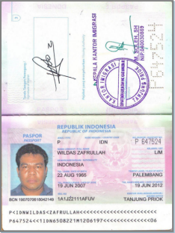
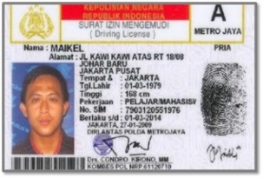
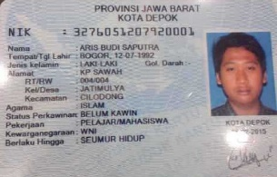
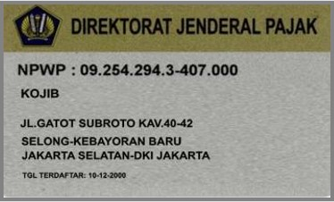
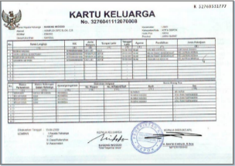
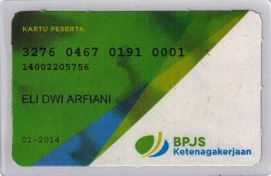
Examples of various official IDs in use
# | Doc | Description | Examples
1 | Passport | Travel document issued by the Directorate General of Immigration, Ministry of Justice and Human Rights, and the representatives of Indonesia abroad. People only have it if they travelled abroad.
2 | Driving license | Any person driving a motor vehicle on the road is required to have driving license. Applicant requirements are: 1. >17 years old 2. KTP (ID Card)
3 | KTP | Residents’ official identity card issued by the government. Required for all Indonesian citizens aged >17 and all foreign workers.
4 | Tax ID | The mean of tax administration that is used to identify of the taxpayer. KTP is required to obtain Tax ID.
5 | Family Book | Family identity card containing info about the structure, relationships and the number of family members. Each family is required to have one.
6 | Medical Insurance/ Pension Card | Given out as a part of public program to provide protection to workers. The program contains of: 1. Pension program 2. Work Accident Insurance Program 3. Death Insurance Program

Slide 39
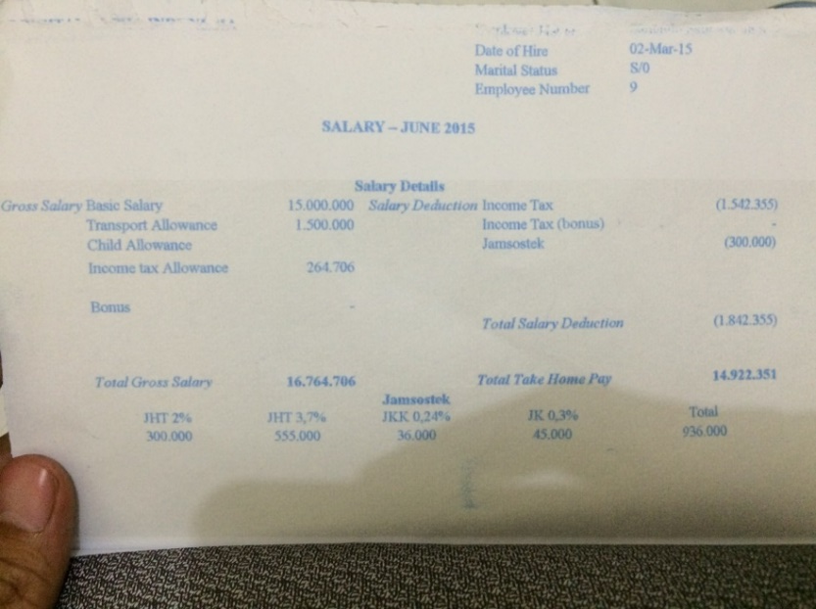
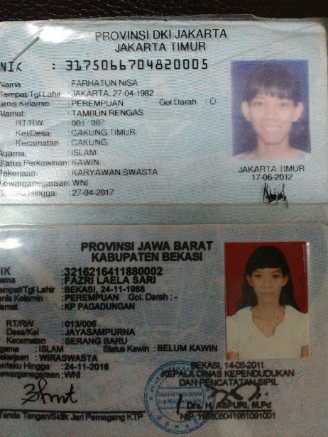
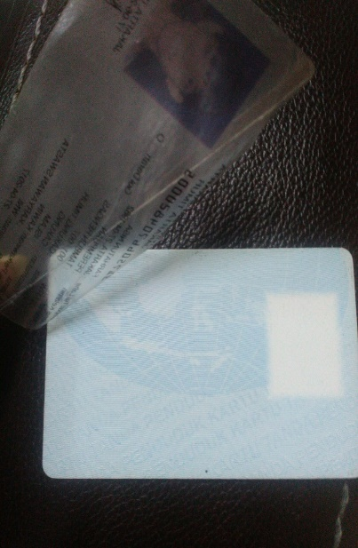
IDs are easily faked…
KTP
Salary slip
Fake ID price is within $7-20.
Production time is less than 1 hour.
Local fast loans issuers (HFC) experience organized fraud attacks with fake IDs.
No means of protection (watermark, stamp, signature).
Currently not used as main income proof documents by local credit institutions.

Slide 40
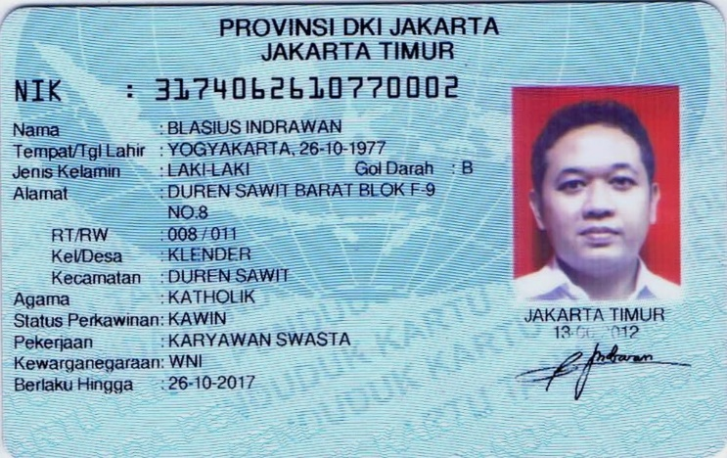
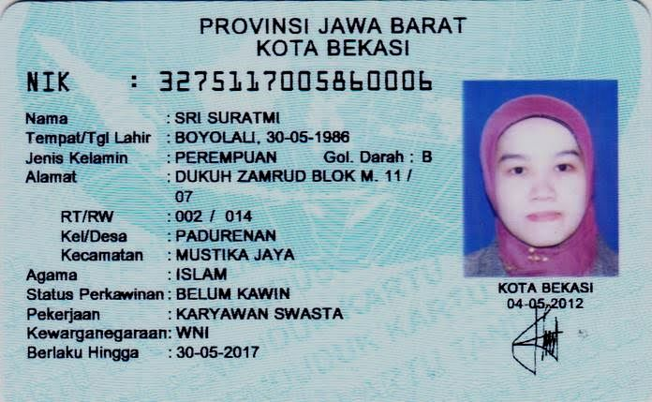
…KTP ID validating capabilities
Below are the tools that are used by local anti-fraud specialists to validate KTP
Person born in odd year will have the picture in red
Person born in even year will have the picture in blue
For males, 7-12 digits will repeat the date of birth in format DDMMYY
26-10-1977=261077
For females, 7-12 digits will repeat the date of birth in format DDMMYY, but 7th digit would be increased by 4:
30-05-1986 = (3+4)=700586
First 2 digits of KTP assigned for certain traceable areas
Conducting 100% “3 in 1” phone verification is the most effective tool to mitigate the risk of fake documents. We plan to start using it as an obligatory check from the very beginning together with traditional manual data checking and Social media validation and Telecom scoring (the last to be introduced on Phase 2).

Slide 41
Risks costs & Risk action plan
Start with the General stop factors, KTP validity check, auto credit rules, 100% phone verification check (3x), 100% data checking, disbursement through bank account only
Implement new automatic anti-fraud rules and social validation
Implement first internal scorecard (to be updated constantly)
New scorecards updated with data from FB
New scorecards updated with data from telecoms
Using the behavior data from telecoms
Using web history data
Implementing in-house web-scoring

Slide 42
Decisioning procedure general description
# | Check | Procedure | Auto/Manual | System
1 | Basic stop-factors | Checking data, entered in the fields of the online application from. | Auto | Website
2 | SMS verification check | Verifies mobile phone number and its availability. | Auto | Website
3 | Web robot check | Verify KTP, applicant’s name, address. | Auto | Website
4 | Social-demographic scoring | Checking age, employment, resident, income, etc. | Auto | Website
5 | Social validation and initial documents verification | Through “Iamreal”. Validates Facebook account of the applicant. | Auto | Website
6 | Black List check | Checking if the applicant is in the uploaded list of bad customers. | Auto | CRM
7 | Anti-fraud check | In-house check basing on different service data. | Auto | CRM
8 | Credit bureau (selective) check | Through the partners with access to credit bureaus (Phase 2). | Auto | CRM
9 | Credit rules | Assessment of the results of the checks done, defining loan amount. | Auto | CRM
10 | Work phone verification | Checking information provided by potential customer, check for obvious signs of fraud, check for negative information about the customer. | Semi-Auto | CRM
11 | Spouse/close Relative verification | Checking information provided by potential customer, check for obvious signs of fraud, check for negative information about the customer. | Semi-Auto | CRM
12 | Mobile phone verification | Checking information provided by potential customer, check for obvious signs of fraud. | Semi-Auto | CRM
13 | Documents’ scans verification | Checking information provided by potential customer, check for obvious signs of fraud. | Semi-Auto | CRM
14 | Disbursement via bank account | We will disburse loans inly to customer’s account at bank to ensure obligatory KYC check done by the bank. | Outsourced
Notes:
Дописать про MLAS

Slide 43
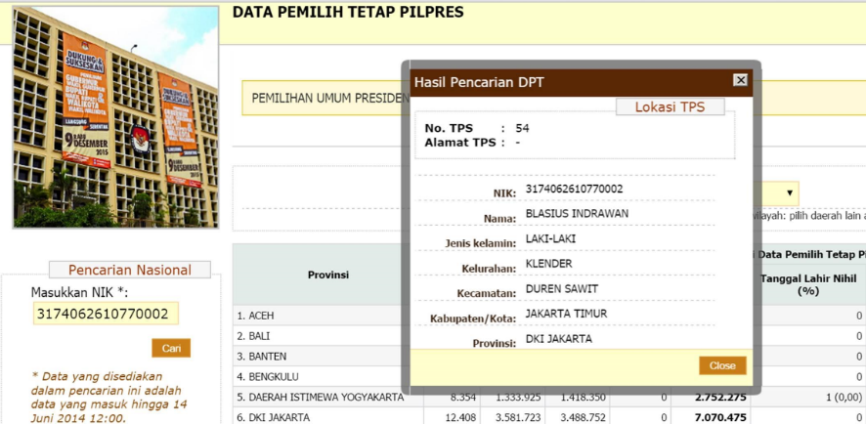
Key inhouse risk activities
Web-robot to validate ID (KTP).
State data base of ~180M unique IDs
When entering the ID number, you can check - if it is valid
- ID holder sex
- ID holder residence province
We will develop web-robot that will check it automatically.
Anti-fraud rules.
We will implement anti-fraud rules developed by Pareto Pulse (Singaporean anti-fraud software developer).
SMS verification.
We will verify the phone number of the customer
via sending digital code with SMS.

Slide 44

Key outsourced risk activities
Israeli online validation company
Service provided:
- Video face verification
- Social network (Facebook) verification
- SMS verification
- Social network quality prediction
Estimated hit rate among internet users: 78%
First privately-owned CB in Indonesia
Starts operations in Nov 2015
Has access to state CB data base
Will formalize the state CB data in convenient way
Formally cannot cooperate with unlicensed (by OJK) entities
Creative scheme is being developed to cooperate with them
Estimated hit rate: 20%

Slide 45
Orgchart (Top Level)
Initial organization chart
CEO
Aditya Prihartono
Feb 2016
Country Manager
Anton Kolobov
Aug 2015
Will be hired until March 2016
Head of HR,Adm&Fin
Rusi Meylani
Sep 2015
Chief Legal Officer
Vacancy
Chief Risk Officer
Asri Anjarsari
Chief Operations Officer
Sutrisno
Nov 2015
Head of IT
Blasius Indrawan
Sep 2015
Chief Marketing Officer
Head of Sales
Head of HR
Vacancy
Legal Manager
Vacancy
1
Risk Manager
Vacancy
1
Anti-Fraud Manager
Vacancy
1
Head of Verifications
Vacancy
1
Head of Call Center
Vacancy
1
Head of Collections
Vacancy
1
Head of Operational Excellence
Vacancy
1
Online Marketing Manager
Ben Mardanu
Dec 2015
Offline Marketing Manager
Vacancy
HR Manager
Vacancy 1
Data Scientist
Vacancy
2
Verification Team
Inbound Team
Head of Outbound
Vacancy
1
Collections Team
Sales Manager
Executive Secretary
Ekky Rerena Tashya
Nov 2015
Phone Verification
Team
Sales
Team
Training and Hiring Team
Quality Control Team

Slide 46
Assumptions and sensitivity analysis
Main Loan parameters
Loan type | Average loan size, USD | Average term | Early repayments | 1st prolongation | 2nd prolongation | Conversion to next tier | Roll-rate 0->1 | Roll-rate 1->2 | Roll rate 2->3+ | Total losses (with prolongations)
Tier 1 loans | 180* | 30 days | 10% | 33% | 11% | 50% | 39% | 70% | 80% | 17,8%
Tier 2 loans | 250 | 30 days | 10% | 33% | 11% | 50% | 20% | 70% | 80% | 9,1%
Tier 3 loans | 320 | 30 days | 10% | 33% | 11% | 50% | 20% | 70% | 80% | 9,1%
"Free loans": 150 USD for 15 days
Income and expenses parameters
Loan type | Normal interest rate, per day | Late penalty interest rate, per day | Disbursement fee received | Prolongation fee received, USD | Marketing acquisition cost, USD
PDL Loans | 1,0% | 1,5% | 0,0% | 11 | 27
Sensitivity analysis
Sensitivity to number of clients | 70% | 80% | 90% | 100% | 110% | 120% | 130% |  | Sensitivity to PDL size | 70% | 80% | 90% | 100% | 110% | 120% | 130%
5 years Profit after taxes | 5 255 | 7 065 | 8 862 | 10 706 | 12 513 | 14 308 | 16 122 |  | 5 years Profit after taxes | -353 | 3 345 | 7 030 | 10 706 | 14 376 | 18 043 | 21 706
5 years average yearly ROE | 34% | 40% | 46% | 51% | 55% | 59% | 63% |  | 5 years average yearly ROE | 10% | 23% | 37% | 51% | 65% | 78% | 91%
Sensitivity to prolongation rates | 70% | 80% | 90% | 100% | 110% | 120% | 130% |  | Sensitivity to conversion rates | 70% | 80% | 90% | 100% | 110% | 120% | 130%
5 years Profit after taxes | 6 599 | 7 965 | 9 339 | 10 706 | 12 077 | 13 443 | 14 810 |  | 5 years Profit after taxes | 2 636 | 4 913 | 7 591 | 10 706 | 14 433 | 18 908 | 24 349
5 years average yearly ROE | 35% | 40% | 46% | 51% | 57% | 62% | 67% |  | 5 years average yearly ROE | 21% | 29% | 39% | 51% | 65% | 80% | 97%
Sensitivity to NPL level | 70% | 80% | 90% | 100% | 110% | 120% | 130% |  | Sensitivity to marketing costs | 70% | 80% | 90% | 100% | 110% | 120% | 130%
5 years Profit after taxes | 14 626 | 13 325 | 12 010 | 10 706 | 9 396 | 8 084 | 6 768 |  | 5 years Profit after taxes | 14 958 | 13 542 | 12 124 | 10 706 | 9 287 | 7 866 | 6 442
5 years average yearly ROE | 77% | 68% | 59% | 51% | 44% | 38% | 32% |  | 5 years average yearly ROE | 74% | 66% | 58% | 51% | 44% | 38% | 32%

Slide 47
Investment Summary
Investment summary |  |  |  | Timeline
thsd USD | Q4’2015 | Year 1 | Year 2 | Year 3 | Year 4 | Year 5* | Total
investments | 201 | 6 663 | 3 590 | 576 | 0 | 0 | 11 030
Total investments | 201 | 6 663 | 3 590 | 576 | 0 | 0 | 11 030
Number of loans issued (thsd) | 0,02 | 41 | 151 | 286 | 408 | 464 | 1 350
Amount disbursed | 3 | 8 438 | 32 726 | 63 401 | 91 682 | 105 535 | 301 786
Net portfolio (EoY) | 1 | 2 148 | 6 155 | 10 837 | 14 555 | 15 708 | 15 708
Revenue | 0 | 2 782 | 14 095 | 29 528 | 44 915 | 53 942 | 145 262
G&A ** | -190 | -3 157 | -2 932 | -3 056 | -3 333 | -3 547 | -16 215
One-off expenses *** | 0 | -908 | 0 | -27 | 0 | 0 | -935
Net profit after taxes | -198 | -3 491 | 744 | 4 508 | 9 144 | 12 807 | 23 512
ROE (yearly) | -197% | -91% | 8% | 40% | 78% | 110% | 51%
ROAA (yearly) |  | -184% | 12% | 42% | 60% | 73% | 39%
* - normalized year with no growth
** - see slide 48 for details
*** - see slide 49 for details
Break-even period – 20 months
Payback period – 50 months
Maximum investments from – 11,0 mln. USD

Slide 48
Balance sheet
Balance Sheet (EOY) | Timeline
thsd USD | Q4’2015 | Year 1 | Year 2 | Year 3 | Year 4 | Year 5
Assets | 3 | 3 795 | 8 128 | 13 212 | 17 052 | 18 077
Liquid assets | 0 | 1 007 | 1 408 | 1 916 | 2 232 | 2 353
Loans to individuals (net of provisions) | 2 | 2 282 | 6 338 | 11 038 | 14 686 | 15 714
PDL | 3 | 3 395 | 11 636 | 24 364 | 39 537 | 53 750
Risk provisions - PDL | 0 | -1 113 | -5 299 | -13 325 | -24 851 | -38 037
Noncurrent assets | 0 | 506 | 382 | 258 | 134 | 10
Liabilities | 3 | 2 970 | 6 047 | 6 623 | 6 623 | 6 623
Loans from | 3 | 2 970 | 6 047 | 6 623 | 6 623 | 6 623
Shareholders' equity | 0 | 825 | 2 081 | 6 589 | 10 429 | 11 454
Contributed equity | 199 | 4 514 | 5 027 | 5 027 | 5 027 | 5 027
Retained earnings | -198 | -3 689 | -2 945 | 1 562 | 5 403 | 6 427

Slide 49
P&L Statement
P&L |  |  |  | Timeline
thsd USD | Q4’2015 | Year 1 | Year 2 | Year 3 | Year 4 | Year 5 | Total
Revenue | 0 | 2 782 | 14 095 | 29 528 | 44 915 | 53 942 | 145 262
Risk provisions | 0 | -1 113 | -4 186 | -8 027 | -11 526 | -13 186 | -38 037
% of revenue |  | -40% | -30% | -27% | -26% | -24% | -26%
Acquisition costs - marketing | -1 | -1 057 | -3 659 | -6 953 | -9 918 | -11 282 | -32 869
% of revenue |  | -38% | -26% | -24% | -22% | -21% | -23%
Acquisition costs - other | -5 | -293 | -889 | -1 611 | -2 233 | -2 494 | -7 524
% of revenue |  | -11% | -6% | -5% | -5% | -5% | -5%
Support costs | -3 | -181 | -781 | -1 619 | -2 464 | -2 974 | -8 024
% of revenue |  | -7% | -6% | -5% | -5% | -6% | -6%
VAT | 0 | -62 | -749 | -1 767 | -2 845 | -3 513 | -8 937
Operating profit (before fixed costs) | -8 | 75 | 3 831 | 9 552 | 15 929 | 20 492 | 49 872
% of revenue |  | 3% | 27% | 32% | 35% | 38% | 34%
G&A | -190 | -3 157 | -2 932 | -3 056 | -3 333 | -3 547 | -16 215
% of revenue |  | -114% | -21% | -10% | -7% | -7% | -11%
One-off expenses | 0 | -288 | 0 | -27 | 0 | 0 | -315
Depreciation and amortization | 0 | -114 | -124 | -124 | -124 | -124 | -609
Profit before Taxes | -198 | -3 484 | 775 | 6 345 | 12 472 | 16 821 | 32 732
% of revenue |  | -125% | 5% | 21% | 28% | 31% | 23%
Income tax | 0 | -7 | -32 | -1 838 | -3 329 | -4 014 | -9 219
Profit after Taxes | -198 | -3 491 | 744 | 4 508 | 9 144 | 12 807 | 23 512
% of revenue |  | -125% | 5% | 15% | 20% | 24% | 16%

Slide 50
Cash flow statement
Cash flow statement |  |  |  | Timeline
thsd USD | Year 0 | Year 1 | Year 2 | Year 3 | Year 4 | Year 5 | Total
Cash flow from operations | -198 | -1 976 | 5 053 | 12 685 | 20 793 | 26 116 | 62 474
Income | 0 | 2 801 | 14 168 | 29 670 | 45 118 | 54 175 | 145 932
Acquisition costs | -5 | -1 350 | -4 548 | -8 563 | -12 151 | -13 777 | -40 393
Support costs | -3 | -181 | -781 | -1 619 | -2 464 | -2 974 | -8 024
G&A | -190 | -3 157 | -2 932 | -3 056 | -3 333 | -3 547 | -16 215
VAT | 0 | -62 | -749 | -1 767 | -2 845 | -3 513 | -8 937
CIT | 0 | -7 | -32 | -1 838 | -3 329 | -4 014 | -9 219
Cash flow from investing | -3 | -4 300 | -8 242 | -12 754 | -15 174 | -14 213 | -54 685
PDL Loans disbursed | -3 | -11 436 | -46 119 | -90 352 | -131 671 | -152 555 | -432 136
PDL Loans repaid | 1 | 8 044 | 37 877 | 77 624 | 116 497 | 138 342 | 378 385
Fixed assets & software | 0 | -908 | 0 | -27 | 0 | 0 | -935
Cash flow from financing | 201 | 6 663 | 3 590 | 576 | -5 303 | -11 782 | -6 055
Contributed equity | 199 | 3 696 | 513 | 0 | 0 | 0 | 4 407
Loans from | 3 | 2 967 | 3 077 | 576 | 0 | 0 | 6 623
External debt financing | 0 | 0 | 0 | 0 | 0 | 0 | 0
Dividends paid | 0 | 0 | 0 | 0 | -5 303 | -11 782 | -17 085
Cash flow total | 0 | 387 | 401 | 508 | 316 | 121 | 1 733

Slide 51
G&A
G&A, thsd USD |  |  |  | Timeline
Expenses category | Year 0 | Year 1 | Year 2 | Year 3 | Year 4 | Year 5 | Total
Salary | 67 | 1 762 | 1 893 | 1 884 | 2 160 | 2 374 | 10 140
Rent | 14 | 324 | 330 | 476 | 476 | 476 | 2 094
Marketing & PR | 0 | 124 | 124 | 124 | 124 | 124 | 620
IT | 77 | 361 | 281 | 377 | 377 | 377 | 1 852
Legal | 0 | 48 | 12 | 12 | 12 | 12 | 96
Travel | 0 | 48 | 48 | 48 | 48 | 48 | 240
Contingency | 32 | 490 | 244 | 135 | 136 | 136 | 1 173
Total | 190 | 3 157 | 2 932 | 3 056 | 3 333 | 3 547 | 16 215

Slide 52
One-off budget
One-off expenses, thsd USD | Total |  | Type
Expenses category
Licensing | 15
MCC registration | 15 |  | Written-off to expenses
Offices | 463 |  | Capitalized
IT | 283
Terrasoft adaptation & translation | 75 |  | Capitalized
Web portal development | 100 |  | Capitalized
P2P Web Site development | 15 |  | Capitalized
Contact center licenses | 57 |  | Capitalized
Contact center implementation | 7 |  | Written-off to expenses
IMREAL (Social Validation Service) | 7 |  | Written-off to expenses
Indonesian Cloud | 2 |  | Written-off to expenses
Netsistem - PC & peripherals | 5 |  | Capitalized
Netsistem - Network Equipment | 3 |  | Capitalized
Recruiting | 100 |  | Written-off to expenses
Brand registration | 73 |  | Capitalized
Total | 935

Slide 53
Main identified risks and their mitigation
# | Risk type | Risk | Mitigation tool
1 | Regulatory | Regulator might start regulating P2P scheme in the future | We will monitor the regulator’s action (currently no any activity detected) and will try to adjust our business model to potential regulations. As the worst scenario we will activate Plan B - obtaining MFC credit institution license and will share licensing action plan with authorities.
2 | Operational | Invalid and/or incorrect personal data in online application (on web site or in CRM) | Built-in auto online checks. Obligatory mobile number SMS-verification procedure.
 |  | Loose customers application data | Saving all signature in CRM and everyday back up.
 |  | Technical bugs during process | Every week testing process with staff and IT.
3 | Behavioral | The customer will claim that he did not take the loan and did not sign the loan agreement | Automatic compilation and sending to the Borrower PDF file of the credit contract text, concluded between Investor&Borrower. PDF will contain both parties personal data and information about exact time of signing and SMS-codes used as signatures. PDF will be sent via email immediately after the loan approval. Requesting explicit Borrower’s consent during confirmation phone call before loan disbursement, recording conversation and storing it to be restored in case of disputes.
4 | Risk-related | Most of the working population is not officially employed, apart from that up to 80% of salary slips are claimed fraud | We will start low volume issuances first to test the market and gain solid statistics base.

Slide 54
Main identified risks and their mitigation (cont)
# | Risk type | Risk | Mitigation tool
4 | Fraudulent | Fake ID using for application | Mandatory requirement of KTP ID, checked via state data base. Using phone verification to identify person. Using Iamreal to identify person in Facebook. Providing loan only to bank account to ensure the KYC procedure.
 |  | Using robots for mass application fulfilling | Obligatory mobile number SMS-verification. Using Facebook verification. Developing mobile app for better verification and scoring.
 |  | Fraudsters attack | Applied anti-fraud rules. Automated black lists check and phone verification. Low initial loan amount (to minimize losses).
 |  | Customers will apply for 2nd loan to close 1st loan | Deduplication check will be applied in CRM.
 |  | Telemarketing and verification staff will be in cahoots with borrowers | Analyzing performance of each staff member. Cross-check and randomizing areas which staff cover in operations.
5 | Collections | Customers unavailability in case of committing delinquency | Mandatory request of providing family member’s mobile number in application in case of collections necessity. Obtaining work and home numbers.
 |  | Denying loan receipt in case of not repaying | Encrypting and storing digital signature data to be presented in court in selected cases.

Slide 55

Project plan and next steps
Activity | Planning end date | Comments
Hiring CEO | February 2016 | CEO is hired, will starting working in February
Licensing | November 2015 | License is obtained
Renting office | February 2015 | Temporary office is rented, permanent is in the search stage
Creating team | December 2016 | Key team members (Risks, IT, Ops, HR, Finance) are hired
IT settings, product settings | December 2015 | All local vendors are contracted, Terrasoft integration is on; fist supply took place in Dec, final will take place in Feb
Official documents | December 2015 | Internal documents are ready and clients documents are to be finalized December 2015
Start sales | December 2015 | We plan to do the first sale in 1H of December
Activity | Sep-15 | Oct-15 | Nov-15 | Dec-15 | Jan-15
Hiring CEO
Licensing
Renting office
Creating team
IT settings, product settings
Legal Setup for our business process
Start operations
We are planning to launch operations in 1H of December 2015.

Slide 56
Appendix 1. Crowdo (P2P) Case Study Business Processes
Contractual Relations
Third parties
2
4
Borrower’s data
check
1
Facility Request
Facility Request
Investors
Crowdo
Borrower
Participation agreement
Loan Master Agreement
Loan Underlying Agreement
5
3
Tops up the trust account at Crowdo
Cash Flow
1
Transfer Investor’s money to the Borrower
2
Investor
Crowdo
Borrower
Repays the loan+%
Transfers the rest
to the Investor
3
5
Deducts the service fee
4

Slide 57
Appendix 2. Mekar Exchange Case Study (P2P) Business Process
Business Process
4
funds the
Lona application
3
publishes the
Approved loan applications
2
approves/rejects
Loan application
1
sends the loan application
to Cooperative
Lender
Mekar Exchange
(ME)
Cooperative (partner)
Borrower
Data checking
Field verification
Contractual Obligations
T&C
Accepting via web
Master Agreement
Guaranteeing 100%
body repayment
Loan Agreement
Lender
Mekar Exchange
(ME)
Cooperative (partner)
Borrower
IOU principle
Loan Agreement
Scanned copy

Slide 58
Appendix 2. Mekar Exchange Case Study (P2P) Cash Flow and Pricing (Cont)
3% p.a.
In revenue
1
2
4
Transfers the funds to
ME banks account
Per Lender’s request transfers
the funds to the Cooperative
Transfer the funds to the
final Borrower
Lender
interest
9% p.a.
Mekar Exchange
(ME)
interest
12% p.a.
Cooperative (partner)
interest
24% p.a.
Borrower
Per Cooperative request transfers
the funds to the Lender
Transfers the funds to
ME bank account
Provides the pledge
Repays the loan
3
7
6
5
Due to the fact that Mekar exercised the funds transfer they felt they need OJK license
OJK stated that it does not have formulated opinion about the business model
OJK proposed the business to grow big first and then they would come to regulate it

Slide 59

Appendix 3. Our approach towards investor base
We are taking retail deposits market as our benchmark.
At Phase 2 we will gradually capture investors keeping in mind the regulatory landscape and market practice.
# | Specifics | Approach
1 | All deposits below $140K are guaranteed by Indonesia Deposit Insurance Corporation | Providing secured product is not a competitive advantage
2 | All deposits below $140K are subject to interest rate cap of 7,75% p.a. and 20% withholding tax | Majority of population can only get an effective yield which is comparable to BI key interest rate (currently 7,50%), offering higher yield is a competitive advantage
3 | Personal presence is needed to open the deposit, yet after the first visit remote depositing is possible | Online product offering is a competitive advantage
4 | Limited number of banks offer small ticket deposits ($70), most of the banks start from $500 | Offering small ticket deposit product is a competitive advantage
5 | Most of the banks offer flexible tenors (1-24 months) | Offering flexible tenors is not a competitive advantage
Indonesia Deposits Insurance Corporation:
Launched in 2005
Independent from BI and OJK
Main functions are:
Deposits insurance
Banks rescue
Banks liquidation
Our unique product offering is high-return but still secured, convenient ticket size on-line deposit

